Slide 1

Aggressive Language Classifier
Natural Language Processing
Date: July 1st, 2020
Team: Manoj Kolpe Lingappa and Alan Gomez
Github: https://github.com/alanorlando95/Aggressive-language-classifier
Google colab : https://colab.research.google.com/drive/1AMwk1apDr-WZaKd66H00MfFB2XJcwUAU?usp=sharing

Slide 2
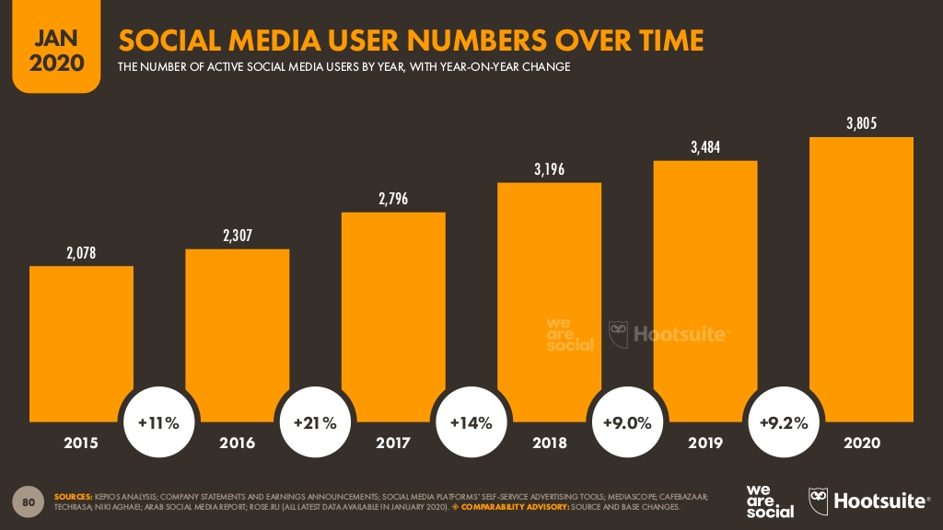
Motivation
Aggressive Language Classifier - Manoj, Alan
Fig 1. Social media users over time (in millions) [1].

Slide 3

Motivation
Aggressive Language Classifier - Manoj, Alan
87 percent of young people in the USA have seen cyberbullying occurring online (2017 - 2019) [2].
36.5 percent of people in the USA feel they have been cyberbullied in their lifetime (2017 - 2019) [2].

Slide 4
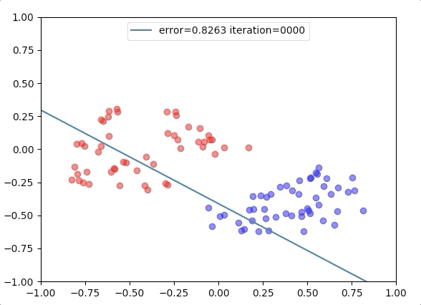
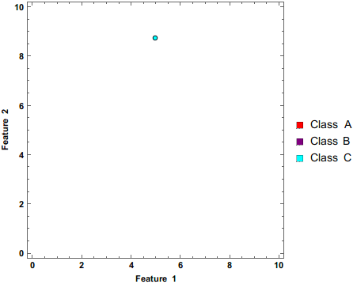
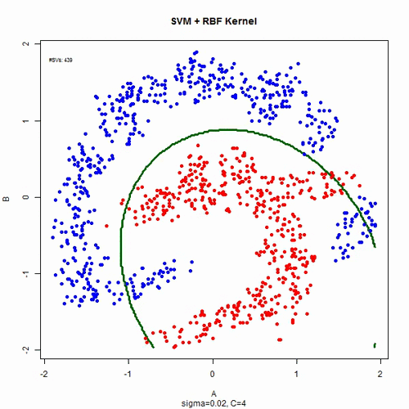
Modern problems require modern solutions (maybe not too modern)
Aggressive Language Classifier - Manoj, Alan
Logistic Regression
Naive Bayes
Support Vector Machine
Logistic regression
Credits: https://brainbomb.org/Artificial-Intelligence/Machine-Learning/ML-Linear-Classification-Logistic-Regression/
Naive bayes
Credits: https://commons.wikimedia.org/wiki/File:Naive_Bayes_Classifier.gif
SVM
Credits: https://gfycat.com/sentimentalthickbullfrog

Slide 5

Dataset
Aggressive Language Classifier - Manoj, Alan
Jigsaw Multilingual Toxic Comment Classification, made up of English comments from Wikipedia’s talk page edits [3].
Credits: https://mc.ai/detecting-toxic-comment/

Slide 6
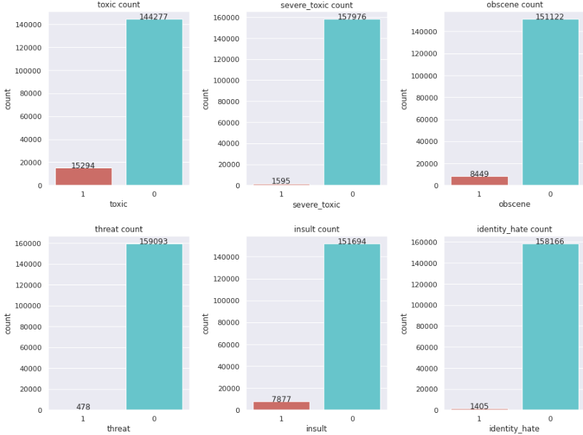
Aggressive Language Classifier - Manoj, Alan

Slide 7
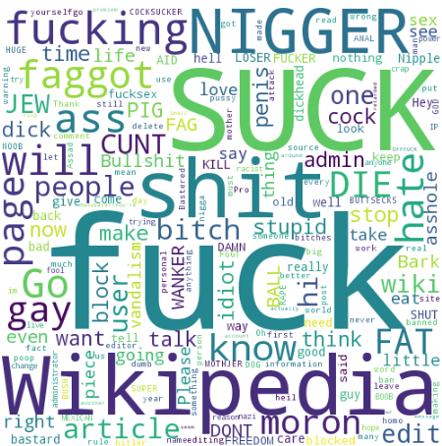
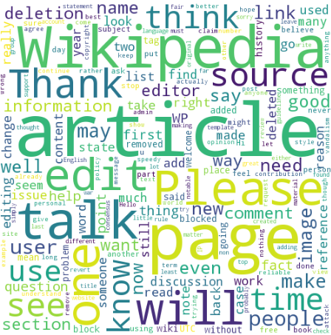
Toxic words Non toxic words
Aggressive Language Classifier - Manoj, Alan

Slide 8
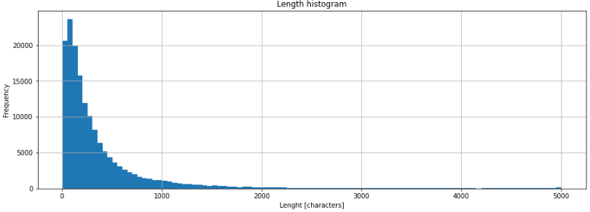
Aggressive Language Classifier - Manoj, Alan

Slide 9
The implementation based on Gaydhani et. al [4]
Aggressive Language Classifier - Manoj, Alan
Train models by performing greedy search with different parameters:
CountVectorizer:
n-gram range ( (1, 1), (1, 2), and (1, 3) )
TfidfTransformer:
norm (L1 and L2)
CountVectorizer extracts the n-gram features
TfidfTransformer weight the n-gram features

Slide 10
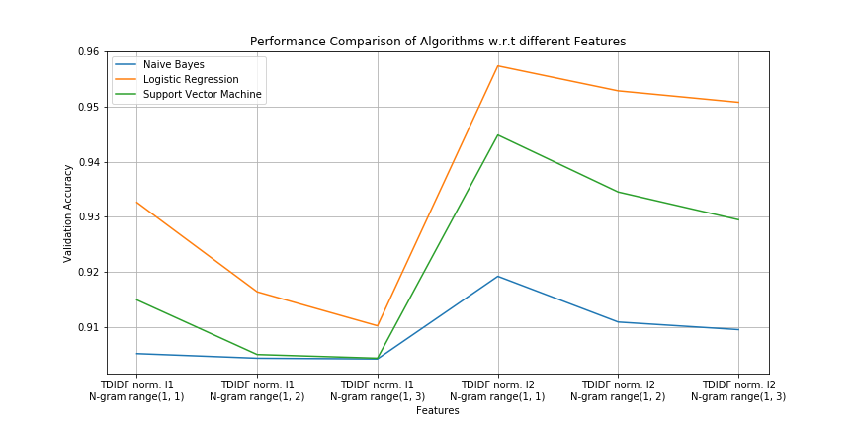
Aggressive Language Classifier - Manoj, Alan

Slide 11
The implementation based on Gaydhani et. al [4]
Aggressive Language Classifier - Manoj, Alan
Compare models
Hyperparameter tuning:
MultinomialNB:
Additive (Laplace/Lidstone) smoothing parameter (0.01, 0.1, 1, and 10)
LogisticRegression:
Inverse of regularization strength (10 and 100)
Solver (newton-cg, liblinear, and saga)
SVM:
Scale of regularization term (0.00001, 0.0001, 0.001, 0.01, and 0.1)

Slide 12
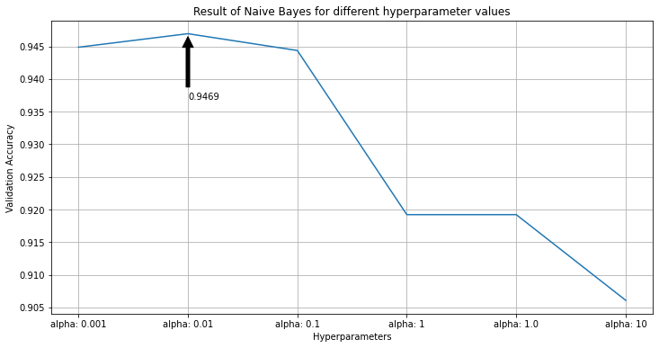
Aggressive Language Classifier - Manoj, Alan

Slide 13
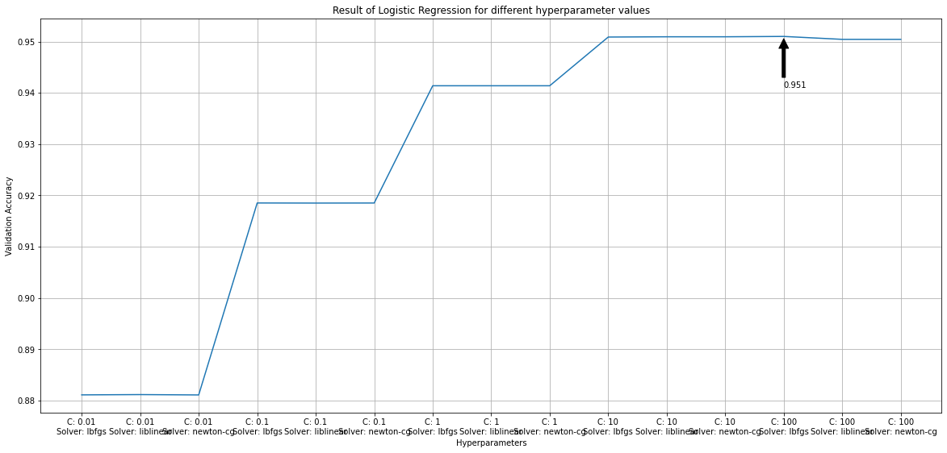
Aggressive Language Classifier - Manoj, Alan

Slide 14
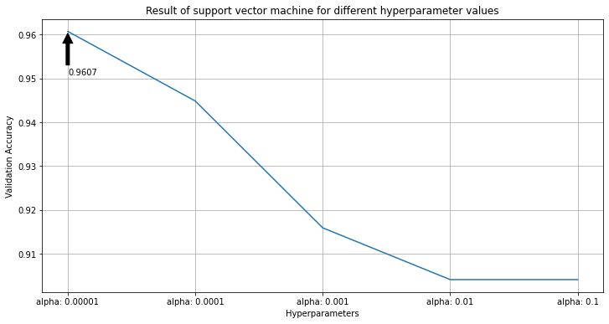
Aggressive Language Classifier - Manoj, Alan

Slide 15
Aggressive Language Classifier - Manoj, Alan
Total data points: 156871
Type of comment: Toxic
Google colab RAM: 12GB | Time taken to train w.r.t different features (min) | Time taken for Hyperparameter Tuning (min)
Naive Bayes | 42 | 7
Logistic regression | 81 | 35
Support vector machine | 52 | 10

Slide 16
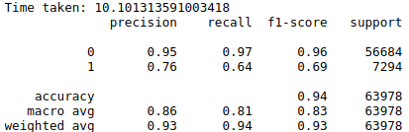
SVM results (toxic)
Aggressive Language Classifier - Manoj, Alan

Slide 17
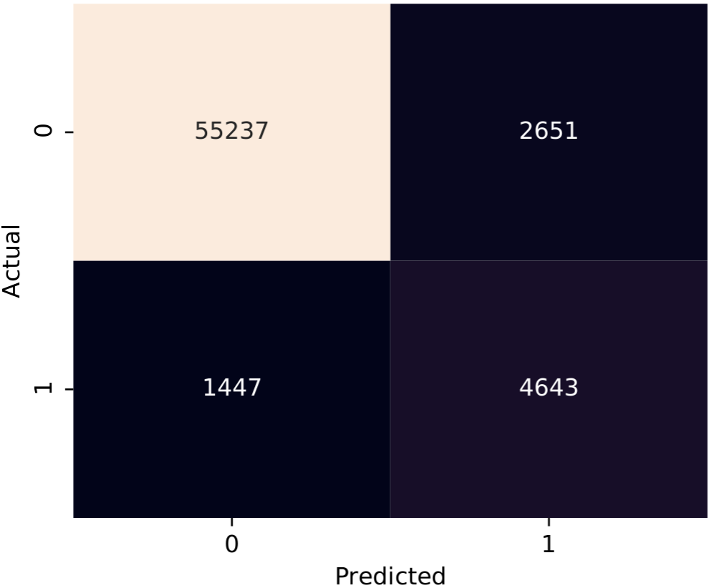
Confusion matrix (toxic)
Aggressive Language Classifier - Manoj, Alan

Slide 18
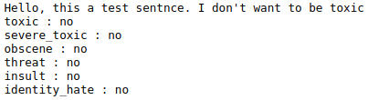
Train the best model to classify the data into the other categories of the dataset
Aggressive Language Classifier - Manoj, Alan
Input
sentence
Results

Slide 19
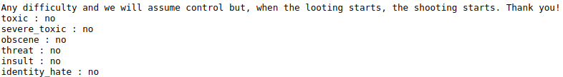
Implicit threats are not detected
Aggressive Language Classifier - Manoj, Alan

Slide 20
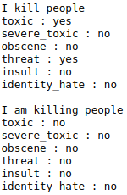
Sensitive to unknown words
Aggressive Language Classifier - Manoj, Alan

Slide 21
Take Home Message
Aggressive Language Classifier - Manoj, Alan
The training data can influence the results on a classification task
Number of positive and negative examples
Unseen words
One can train different models comparing different parameters using sklearn
Different TFIDF norm and n gram range affects the validation accuracy.
Hyperparameter tuning can give better validation accuracy than using gridsearch with respect to different features.
Confusion matrix can be used to describe performance of a classification model.
Traditional solver such as naive bayes, SVM and logistic regression produce reasonable performance in classification of toxic comment.

Slide 22
References
Aggressive Language Classifier - Manoj, Alan
[1] Kemp, Simon. “Digital 2020: Global Digital Overview - DataReportal – Global Digital Insights.” DataReportal. DataReportal – Global Digital Insights, January 30, 2020. https://datareportal.com/reports/digital-2020-global-digital-overview.
[2] “51 Critical Cyberbullying Statistics in 2020.” BroadbandSearch.net. Accessed June 18, 2020. https://www.broadbandsearch.net/blog/cyber-bullying-statistics.
[3] “Jigsaw Multilingual Toxic Comment Classification.” Kaggle. Accessed June 18, 2020. https://www.kaggle.com/c/jigsaw-multilingual-toxic-comment-classification/data.
[4] Gaydhani, Aditya, Vikrant Doma, Shrikant Kendre, and Laxmi Bhagwat. "Detecting hate speech and offensive language on twitter using machine learning: An n-gram and tfidf based approach." arXiv preprint arXiv:1809.08651 (2018).

